Slide 1



System Analysis and Design
Data Flow and Context Diagrams

Slide 2
Data Flow vs Context Diagram
The Context Diagram shows the system under consideration as a single high-level process and then shows the relationship that the system has with other external entities.
Context Diagram = Context-Level Data-Flow Diagram = Level-0 Data Flow Diagram.
Data-Flow Diagram is the general version of Context Diagram.
Shows the system process in detail.

Slide 3
Data Flow vs Context Diagram
Context Diagram
Data Flow Diagram

Slide 4
Context Diagram
This diagram sets out at the very highest level the system boundary; so that we can determine what is inside the system and what is outside the system.
Not modelling the system
The idea is to put the proposed system into context relative to the external actors and other systems with which it interfaces.
The Context Diagram will typically be included in the requirements document in order to get agreement on the proposed system scope from both technical and non-technical stakeholders.

Slide 5
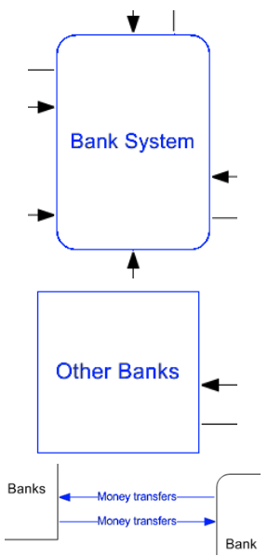
Context Diagram
Basic Elements
Process: means the whole of the proposed system.
The process should be treated as a ‘black box’, the internal details of which are not important at this level of abstraction.

Slide 6
Context Diagram
Basic Elements
External Interface: any external system or human actor that interacts with our system.
The Context Diagram focuses on external actors rather than internal processes.
Interface = Terminator = Input/Output = Entity.

Slide 7
Context Diagram
Basic Elements
Data Flow line: indication of the kind of information that flows from our system (Process) to an external system (Interface) and vice versa.
The data flows in the direction of the arrow.

Slide 8
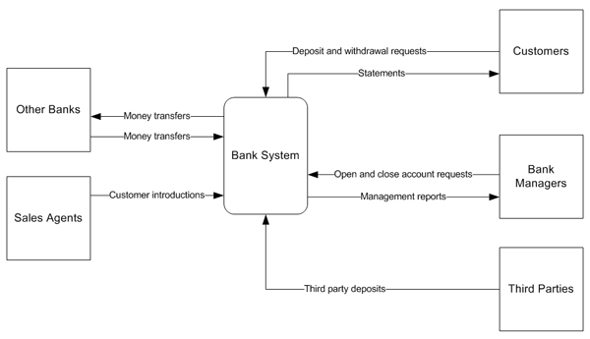
Context Diagram
Example
Bank System encapsulated as a single process that sends data to, and receives data from, various external interfaces.

Slide 9
Context Diagram
Example
Customers can send deposit and withdrawal requests to our system and can receive statements from it.

Slide 10
Context Diagram
Example
Bank Managers can send open and close account requests to the system and can receive management reports from it.

Slide 11
Context Diagram
Example
Third Parties can send third party deposits to the system

Slide 12
Context Diagram
Example
Other Banks which may send or receive money transfers when interacting with our system.

Slide 13
Context Diagram
Example
Sales Agents generate customer introductions for our system.

Slide 14
Context Diagram
Note that while the context diagram shows the kind of data that is exchanged between our system and the external interfaces, it implies nothing at all regarding the sequence in which those data exchanges take place.

Slide 15
Context Diagram
Another name for a Context Diagram is a Context-Level Data-Flow Diagram or a Level-0 Data Flow Diagram.
Shows the scope and boundaries of a system at a glance including the other systems that interface with it

Slide 16
Data Flow vs Context Diagram
Context Diagram
Data Flow Diagram

Slide 17
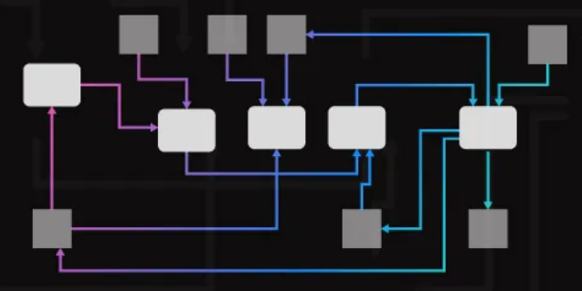
Data Flow Diagram
The Data Flow Diagram (DFD) provides a graphical representation of the flow of data through a system.
It shows logically what information is exchanged by our system processes and external interfaces or data stores.
It does not explicitly show when or in what sequence the information is exchanged.

Slide 18
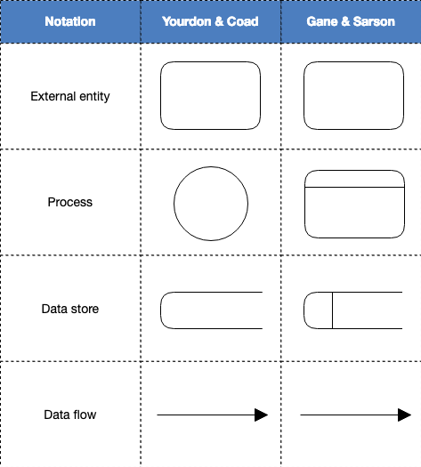
Data Flow Diagram
Diagram Elements

Slide 19
Data Flow Diagram
Diagram Elements
External Interface: any external system or human actor that interacts with our system processes.
In some alternative notations the Interface shape may be known as a Terminator, an Input/Output or an Entity.

Slide 20
Data Flow Diagram
Diagram Elements
Process: consumes data from an Interface or Data Store, transforms it in some way, and then feeds out the result to an Interface or Data Store.

Slide 21
Data Flow Diagram
Diagram Elements
Data Store: represents an entire database or a more specific entity within a database or other persistent data store.

Slide 22
Data Flow Diagram
Diagram Elements
Data Flow: shows data flowing from a Process to an external Interface or Data Store, or data flowing from an external Interface or Data Store to a Process.
The data flows in the direction of the arrow.

Slide 23
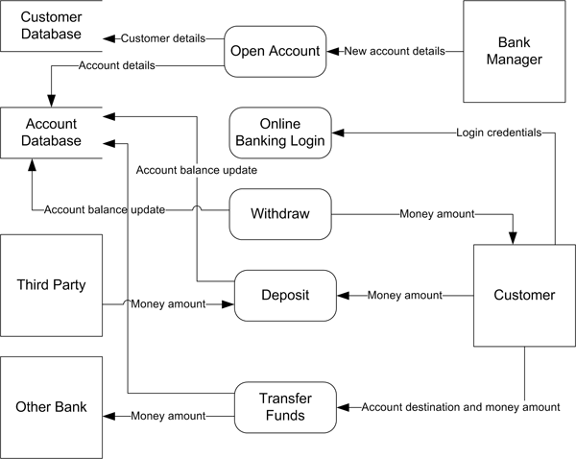
Data Flow Diagram
Example
Determine the processes?
Determine the external entities?
Determine data stores

Slide 24
Data Flow Diagram
Example
A Bank Manager actor provides New account details to the Open Account process which results in Customer details being persisted in the Customer Database data store and Account details being persisted in the Account Database data store.

Slide 25
Data Flow Diagram
Example
A Customer actor using the Online Banking Login process must provide some data in the form of a set of Login credentials such as a username and password.

Slide 26
Data Flow Diagram
Example
A Customer actor can receive a Money amount from the Withdraw process and can supply a Money amount to the Deposit process; in either case causing an Account balance update to the Account Database data store.

Slide 27
Data Flow Diagram
Example
A Customer actor can initiate the Transfer Funds process, to which he provide an Account destination and money amount. The Transfer Funds process can send a Money amount to another bank via the Other Bank interface.

Slide 28
Data Flow Diagram
Example
Third Party actor can make use of the Deposit process by supplying a Money amount.

Slide 29
References
https://www.modernanalyst.com/Resources/Articles/tabid/115/ID/2015/Data-Flow-Diagram-with-Examples-Tips.aspx
https://www.modernanalyst.com/Resources/Articles/tabid/115/ID/2012/Putting-Systems-Analysis-Into-Context-using-the-Context-Diagram.aspx
https://www.modernanalyst.com/Resources/Articles/tabid/115/ID/1355/Introduction-to-Context-Diagrams.aspx
https://www.modernanalyst.com/Careers/InterviewQuestions/tabid/128/ID/1433/What-is-a-Context-Diagram-and-what-are-the-benefits-of-creating-one.aspx

